Slide 1
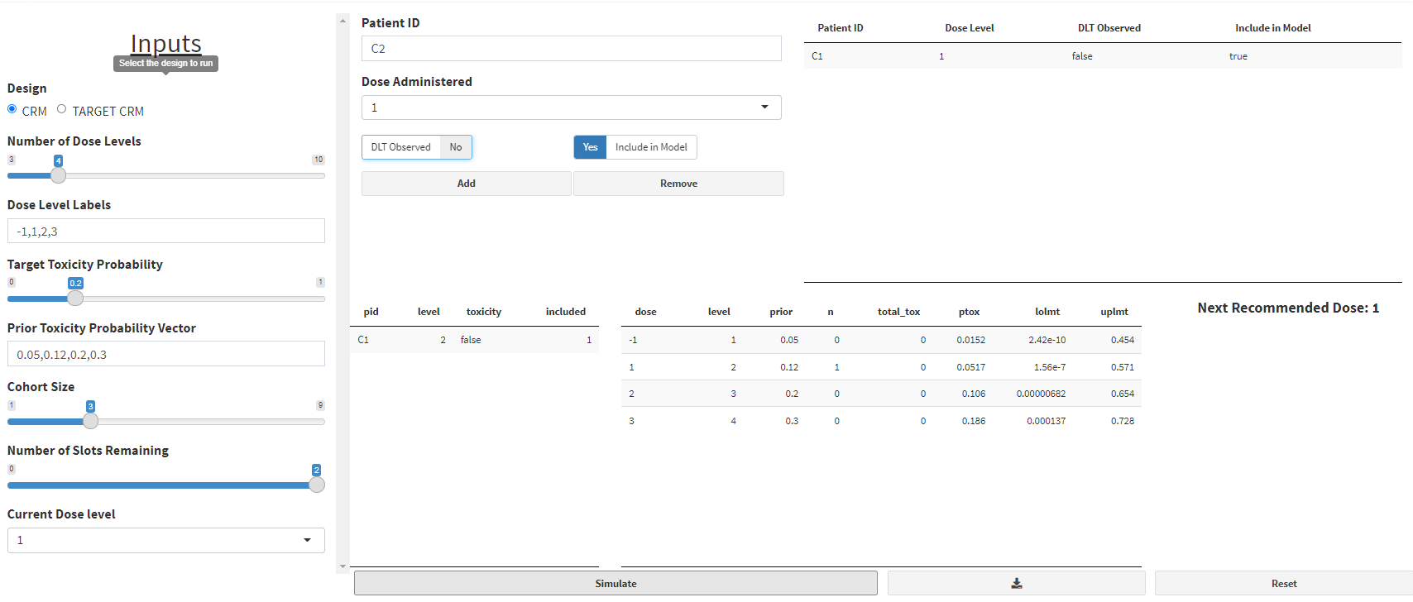
CURRENT VERSION

Slide 2
Enter observed toxicity data for the next patient:
Entered toxicity data
Add new patient
Remove existing patient
Run Model
Dose Administered -> no default dose. User must specify dose level.
For “Number of Slots Remaining”, default to largest value (e.g. Cohort Size-1)

Slide 3
Enter observed toxicity data for the next patient:
Observed toxicity data
Add new patient
Remove existing patient
Run Model
Dose Escalation Recommendations
Trial Design: CRM
Toxicity probability results (with 90 percent probability interval):
Prior
Prob of DLT
Posterior Prob of DLT
Dose
Level
Num
Pts
Num DLTs
Lower Limit
Upper Limit
Output in single column
(scrolling)
Next recommended dose level: 1
Recommendation based on target toxicity probability of 0.2
Additional details:
Current dose level: 1 Cohort size: 3 Number of slots remaining at current dose level: 2
Dose escalation rules:
- No dose skipping upon dose escalation. - Intra-cohort dose de-escalation is allowed. - Intra-cohort dose escalation is not allowed.

Slide 4
Downloadable Report
Dose Escalation Recommendations
Trial Design: CRM
Software: DEDUCE app version 1.0 URL: https://bengarski.shinyapps.io/DELPHI/ [URL TO BE REPLACED] Report Date: Tue Mar 02 14:12:11 2021
Observed toxicity data
Toxicity probability results (with 90 percent probability interval):
Prior
Prob of DLT
Posterior Prob of DLT
Dose
Level
Num
Pts
Num DLTs
Lower Limit
Upper Limit
Additional details:
Current dose level: 1 Cohort size: 3 Number of slots remaining at current dose level: 2
Dose escalation rules:
No dose skipping upon dose escalation. - Intra-cohort dose de-escalation is allowed. - Intra-cohort dose escalation is not allowed.
Estimation details:
Empiric dose-toxicity model: p = dose^{exp(beta)} dose = 0.05 0.1 0.2 0.3 Normal prior on beta with mean 0 and variance 1.34 Posterior mean of beta: 0.75 Posterior variance of beta: 0.698

Slide 5
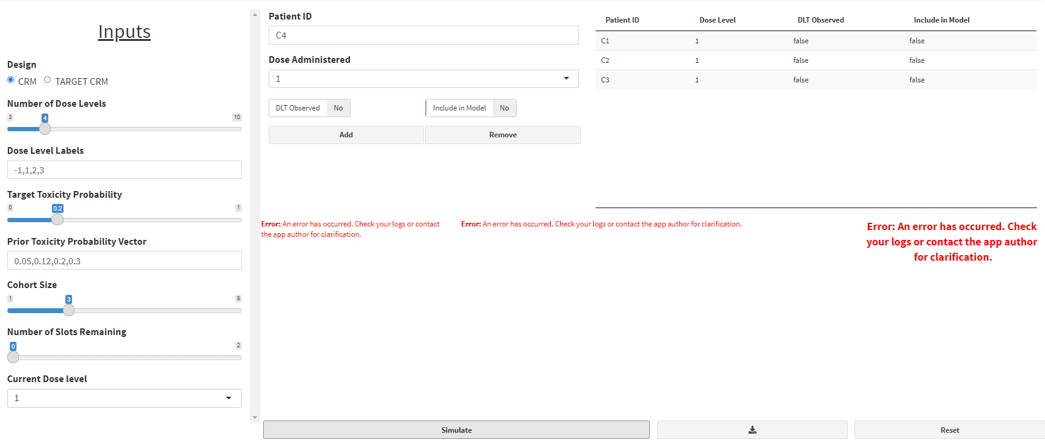
Input error: did not include any patients in the model (Include in Model = false for all patients).
Need to handle error. Output error message and do not run model if length(include)=0.
Desired error message: ERROR: None of the patients have been included in the model. Please enter at least one patient where Include in Model is “Yes”

Slide 6
November 8, 2021
Suggested Revisions

Slide 7
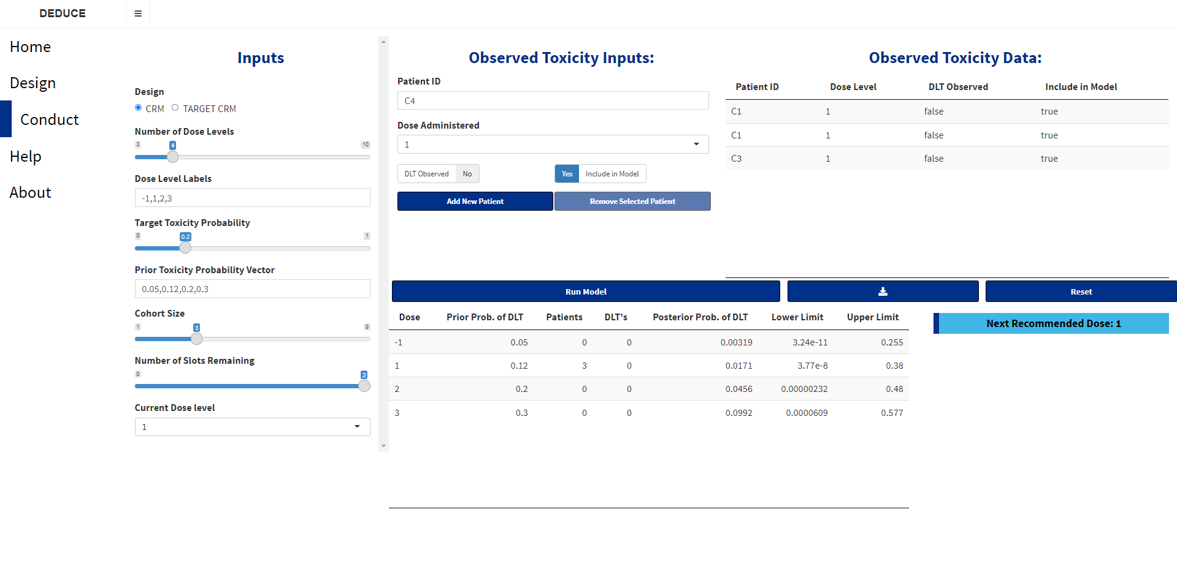
Note: we should use “dose level” rather than “dose”. They mean different things.
Enter toxicity data for next patient:
Administered dose level
Was DLT observed?
Include patient in model?
Dose Escalation Recommendations
Trial Design: CRM
Need to provide context for results table
Toxicity probability results (with 90 percent probability interval):
Dose Level
# Patients # DLTs
Recommended Dose Level: 1
Recommendation based on target toxicity probability of 0.2
If space is an issue,
can column headings wrap to next line?
Additional details:
Current dose level: 1 Cohort size: 3 Number of slots remaining at current dose level: 2
Dose escalation rules:
- No dose skipping upon dose escalation. - Intra-cohort dose de-escalation is allowed. - Intra-cohort dose escalation is not allowed.

